Slide 1
FoodHub Data Analysis
PGP-DSBA _ FoodHub Project
Date 14th September 2023

Slide 2
Contents / Agenda
Executive Summary
Business Problem Overview and Solution Approach
Data Overview
EDA - Univariate Analysis
EDA - Multivariate Analysis
Appendix

Slide 3
Executive Summary: Conclusion (1/11): Intro
This analysis was carried out on data collected from 1898 online food delivery orders made by 1200 clients in New York via the food aggregator company, FoodHub. Altogether, 14 cuisine types were ordered from 178 restaurants. A total of 9 attributes were recorded and analyzed. The principal attributes under scrutiny are the cuisine type and feedback ratings. In an effort to provide actionable information to FoodHub seeking to ameliorate customer experience and improve business performance, we uncovered the relationship between these two main parameters and the other attributes.

Slide 4
Executive Summary: Conclusion (2/11): Volume of Orders
'American' was the most frequently ordered cuisine type (about 580 orders, 30.56%) followed by 'Japanese' (about 480, 25.29%) and 'Italian'(about 280 orders, 14.75%)
'Vietnamese' cuisine type was the least frequently ordered (less than 20 orders, 1.05%)
The number of orders received during the weekend is over twice greater than those received during weekdays. Probably, people tend to use office and school restaurants during weekdays and, therefore, don't need to order food online.
The top 5 restaurants in terms of the number of orders in descending number of orders are 'Shake Shack' (219 orders, 11.54%), 'The Meatball Shop' (132 orders, 6.95%), 'Blue Ribbon Sushi' (119 orders, 6.27%), 'Blue Ribbon Fried Chicken' (96 orders, 5.06%), and 'Parm' (68 orders, 3.58%)
The IDs of the top 3 most frequent customers who will, therefore, be benefitting from the discount are 52832 (13 orders, 0.68%), 47440 (10 orders, 0.53%), and 83287 (9 orders, 0.47%)
All 14 cuisine types were ordered during the weekend

Slide 5
Executive Summary: Conclusion (3/11): Food Preparation Time
It takes between 20 and 35 minutes to prepare food after an order is placed, and 27 minutes on average
The orders received are fairly distributed across food preparation times with peaks at 21, 26, 31, and 34 minutes, meaning relatively large numbers of orders registered preparation times around these peaks
Most orders are prepared between 23 and 31 minutes
Half of the orders are prepared in less than 27 minutes
Thai dishes have the greatest variability in preparation time whereas the least variability is registered for korean dishes
Italian and Thai dishes generally have the longest preparation time followed by Japanese and Spanish dishes whereas Korean and Vietnamese dishes are the most rapidly prepared dishes

Slide 6
Executive Summary: Conclusion (4/11): Food delivery time
most orders are delivered in between 20 and 28 minutes
half of the orders are delivered in less than 25 minutes
The average delivery time is 24.16 minutes
A total of 200 (10.54%) orders were delivered in more than 60 minutes from the time the order is placed
Delivery time during weekdays is significantly higher than during the weekend
Weekend delivery times tend to be more variable than weekday delivery times
On average, orders are delivered in 28 minutes on weekdays and 22 minutes on weekends

Slide 7
Executive Summary: Conclusion (5/11): Cost of orders
most orders cost between 12 and 23 dollars
half of the orders cost less than 14 dollars
555 (29.24%) orders cost above 20 dollars
Southern dishes have the largest variability in cost whereas korean dishes are the least cost variable
French dishes tend to be the most expensive meanwhile vietnamese dishes are the cheapest

Slide 8
Executive Summary: Conclusion (6/11): Ratings
A total of 736 (38.78%) orders are not rated
Among the orders rated, most had a rating of 5 (about 580, 30.56% of all orders) followed by 4 (about 380, 20.02% of all orders
It turns out each restaurant having registered more than 50 ratings also has an average rating of over 4; only 4 (2.25%) restaurants respect these criteria and are, thus, eligible for the promotional offer: 'The Meatball Shop', 'Blue Ribbon Fried Chicken', 'Shake Shack', and 'Blue Ribbon Sushi'

Slide 9
Executive Summary: Conclusion (7/11): Revenue
The top 14 restaurants in terms of revenue raised between 506 and 3580 dollars each from the orders
'Shake Shack' generated the greatest amount of revenue from the orders (3580 dollars) followed by 'The Meatball Shop' (2145 dollars)
Among the top 14 restaurants, 'Five Guys Burgers and Fries' registered the least revenue (506 dollars) followed by 'Nobu Next Door' (623 dollars)
The revenue raised by FoodHub is around 6166.3 dollars

Slide 10
Executive Summary: Conclusion (8/11): Food delivery time vs Rating
Orders with the longest delivery time were generally rated 3 whereas those with the least delivery time were rated 4 on average.

Slide 11
Executive Summary: Conclusion (9/11): Food preparation time vs Rating
There is hardly any observable relationship between the food preparation time and the rating though orders with the longest preparation time and widest preparation time variability register a rating of 3 on average

Slide 12
Executive Summary: Conclusion (10/11): Cost of dishes vs Rating
The variability of cost is greatest for orders rated 3
Among the dishes rated, the most costly dishes are rated 5 whereas the least are rated 3
The cheapest dishes tend not to be rated

Slide 13
Executive Summary: Conclusion (11/11): Food preparation time vs Food delivery time vs Cost
The variability of cost is greatest for orders rated 3
Among the dishes rated, the most costly dishes are rated 5 whereas the least are rated 3
The cheapest dishes tend not to be rated

Slide 14
Executive Summary: Recommendation (1/2)
FoodHub should prospect and make promotion offers to restaurants that serve American, Japanese, and Italian dishes since these three cuisine types account for more than half of orders
Optimal capacity management can be attained by allotting significantly greater logistics allowance (number of delivery cars and personnel and software availability and stability) during the weekend, which registers more than half of orders made during the entire week
Service delivery agents should be stationed close to restaurants serving Japanese and Italian dishes to reduce total delivery time by compensating for the relatively long preparation time of these popular dishes

Slide 15
Executive Summary: Recommendation (2/2)
The greater delivery time during weekdays needs to be investigated considering that a lot fewer orders are received than during weekends
Advertisement of expensive French dishes might result in additional revenue generation
Customer experience should be carefully gauged when advertising expensive dishes to determine whether the average ratings for this class of dishes remain high as the relative number of orders rises
Clients tend to be more sensitive to delivery time than preparation time; so FoodHub should think of cost-effective strategies for delivery time reduction

Slide 16
Business Problem Overview
FoodHub, a food aggregator company providing access to several restaurants in New York via a smartphone app is keen on enhancing customer experience and has reached out to its Data Science team for insights that will help attain this goal. As a member of the Data Science team, I have been given the task to carry out the analysis and provide feedback to Management. The task will be accomplished in two main steps
Analysis of the Data Set
Recommendation of Business Action

Slide 17
Solution Approach (1/2)
A rundown of the approach used in this analysis
General exploration of the dataset to determine main features including number of orders registered, clients, restaurants, cuisine types, and total number of attributes under investigation
Univariate analysis of key attributes, namely the customer ID, restaurant name, cuisine type, day of the week, food preparation time, food delivery time, cost of orders, and ratings
Bivariate analysis uncovering relationships between:
Cuisine type and day of the week
Cuisine type and Food preparation time
Cuisine type and Cost
Food delivery time and day of the week
Food preparation time and Rating

Slide 18
Solution Approach (2/2)
Bivariate analysis uncovering relationships between:
Food delivery time and Rating
Restaurant name and rating
Restaurant name and Cost
Cost and Rating
Multivariate analysis among Food Preparation Time, Food delivery time, and Cost
Synthesis of Observations
Recommendation

Slide 19
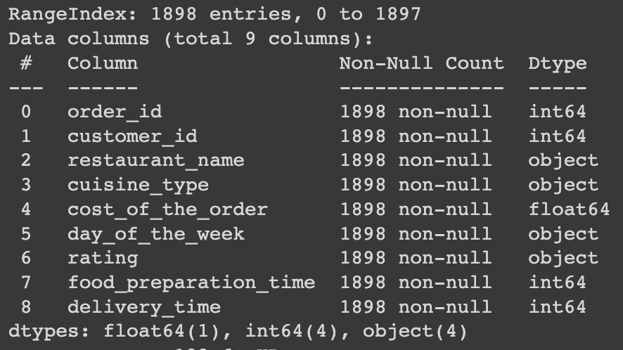
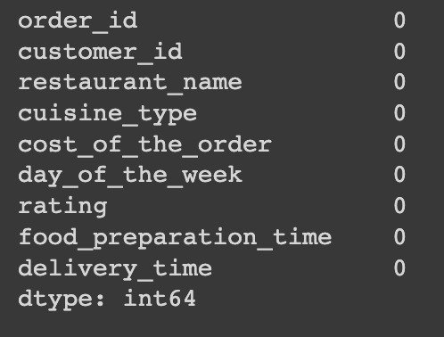
Data Overview (1/2): Data Shape, Datatypes, and Data Completeness
1898 records (rows) and 9 attributes (columns)¹
5 numerical variable columns²:
'order_id', 'customer_id', 'food_preparation_time', and 'delivery_time' have int datatype
'cost_of_the_order' has float datatype
4 columns of object datatype (categorical variables/str) ²: 'restaurant_name', 'cuisine_type', 'day_of_the_week', and 'rating'; strangely 'rating' has an object datatype
No missing values³

Slide 20
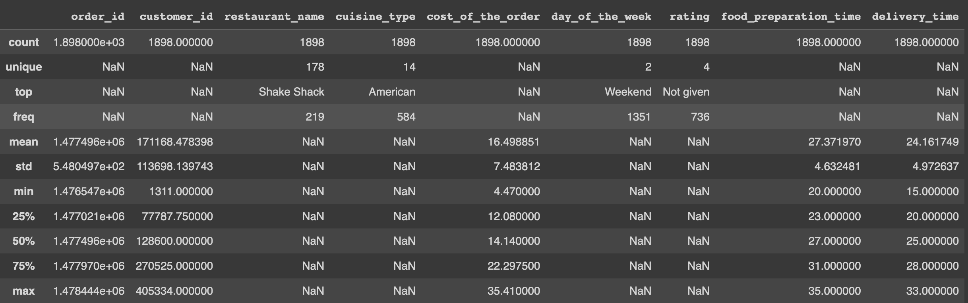

Data Overview (2/2): Statistical Summary
It takes between 20 and 35 minutes to prepare food after an order is placed⁴
The average food preparation time is 27 minutes⁴
A total of 736 (38.78%) orders are not rated⁵.

Slide 21
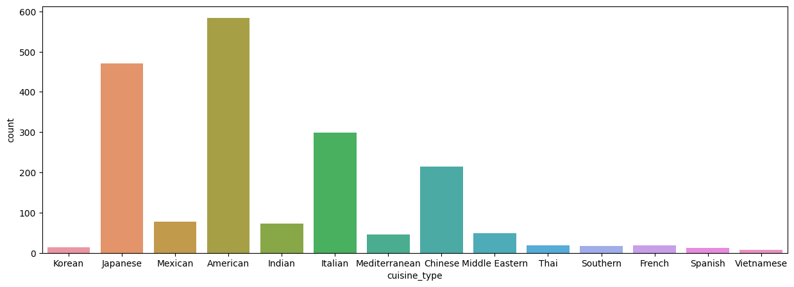
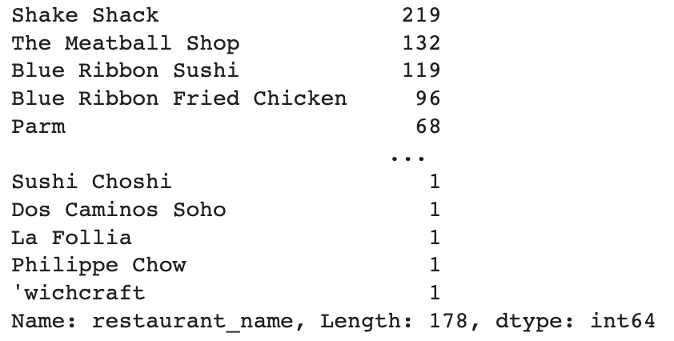
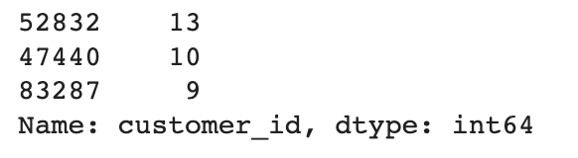
Univariate Analysis (1/6): Order ID, Customer, ID, Restaurant name, and Cuisine type
1898 orders were made by 1200 clients from 178 restaurants^{6, 7, 8}
The IDs of the top 3 most frequent customers who will, therefore, be benefitting from the discount are 52832 (13 orders, 0.68%), 47440 (10 orders, 0.53%), and 83287 (9 orders, 0.47%)⁹
A total of 14 cuisine types were ordered¹⁰
'American' was the most frequently ordered cuisine type (about 580 orders, 30.56%) followed by 'Japanese' (about 480, 25.29%) and 'Italian'(about 280 orders, 14.75%)¹¹
'Vietnamese' cuisine type was the least frequently ordered (less than 20 orders, 1.05%)¹¹
The top 5 restaurants in terms of the number of orders in descending number of orders are 'Shake Shack' (219 orders, 11.54%), 'The Meatball Shop' (132 orders, 6.95%), 'Blue Ribbon Sushi' (119 orders, 6.27%), 'Blue Ribbon Fried Chicken' (96 orders, 5.06%), and 'Parm' (68 orders, 3.58%)¹²

Slide 22
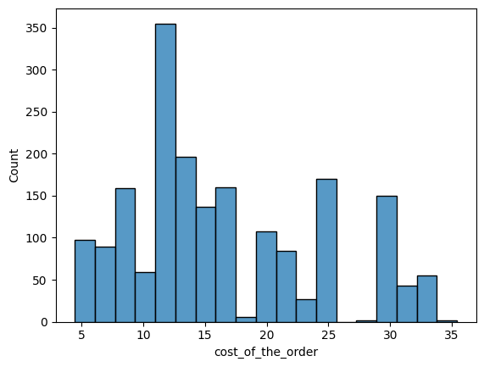
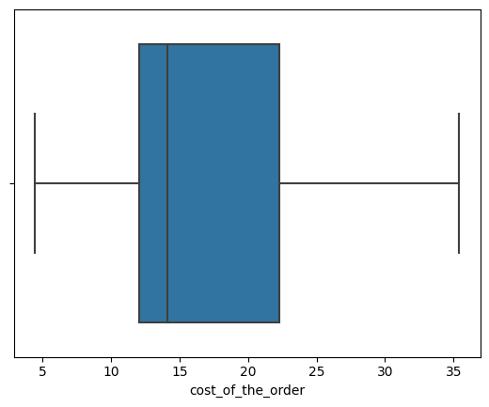
Univariate Analysis (2/6): Cost of order
‘cost_of_the_order' is slightly right-skewed¹³
most orders cost between 12 and 23 dollars¹³
half of the orders cost less than 14 dollars¹³
555 (29.24%) orders cost above 20 dollars¹⁴

Slide 23
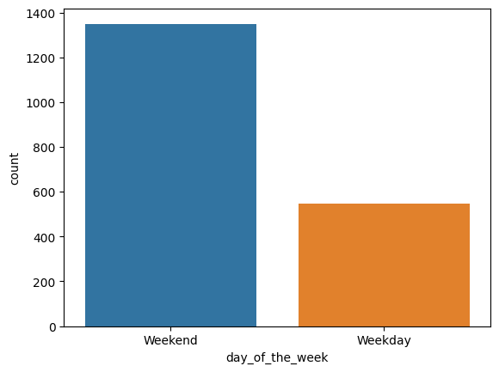
Univariate Analysis (3/6): Day of the week
As expected, 'day_of_the_week' has two values; orders are either placed during weekdays or during the weekend¹⁵
The number of orders received during the weekend is over twice greater than those received during weekdays. Probably, people tend to use office and school restaurants during weekdays and, therefore, don't need to order food online¹⁶

Slide 24
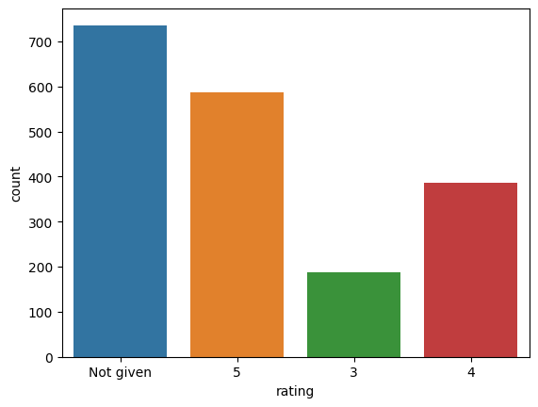
Univariate Analysis (4/6): Rating
The only ratings registered are 3, 4, and 5¹⁷
some orders were not rated (736, 38.78%) ¹⁷.
Among the orders rated, most had a rating of 5 (about 580, 30.56% of all orders) followed by 4 (about 380, 20.02% of all orders) ¹⁸

Slide 25
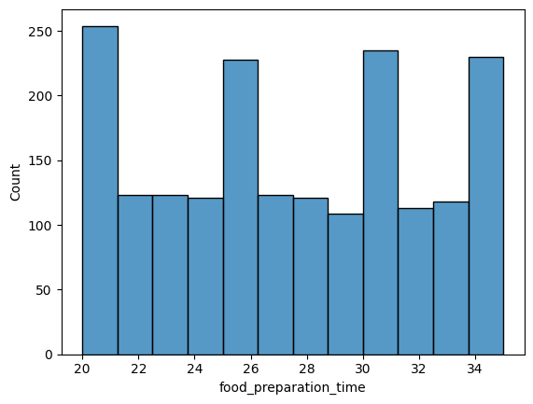
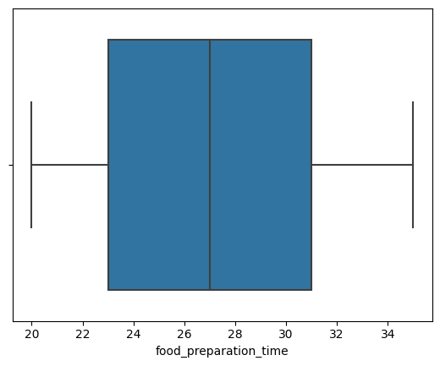
Univariate Analysis (5/6): Food preparation time
The orders received are fairly distributed across food preparation times with peaks at 21, 26, 31, and 34 minutes, meaning relatively large numbers of orders registered preparation times around these peaks¹⁹
Most orders are prepared between 23 and 31 minutes¹⁹
Half of the orders are prepared in less than 27 minutes¹⁹

Slide 26
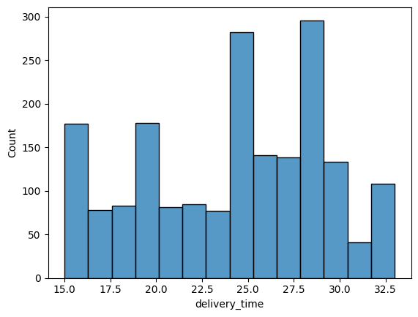
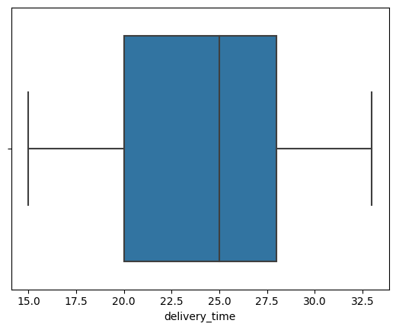
Univariate Analysis (6/6): Food delivery time
'delivery_time' is slightly left-skewed²⁰
most orders are delivered in between 20 and 28 minutes²⁰
half of the orders are delivered in less than 25 minutes²⁰

Slide 27

Multivariate Analysis (1/12): Cuisine Type vs Day of the Week
All 14 cuisine types were ordered during the weekend²¹

Slide 28
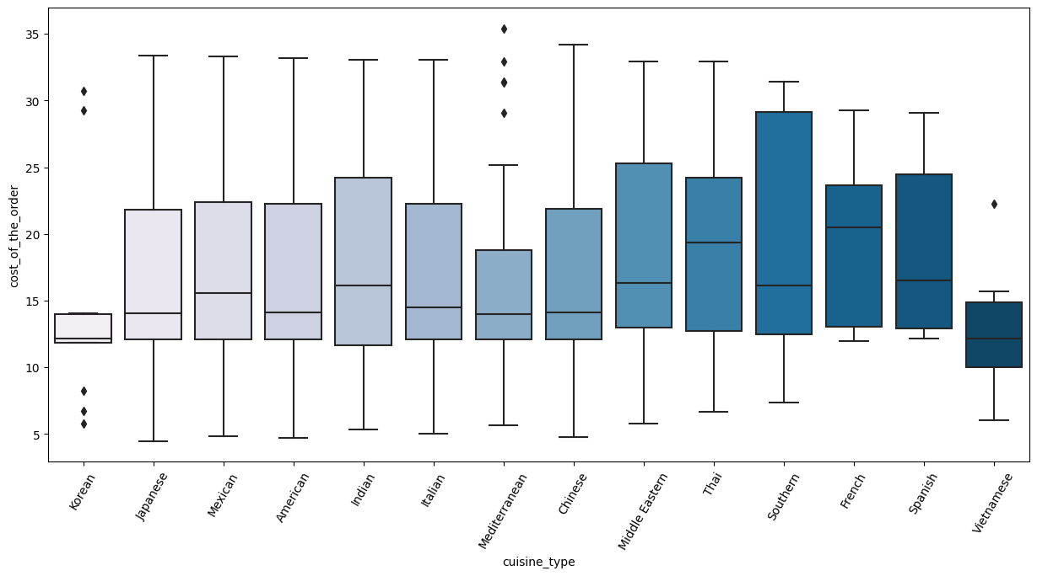
Multivariate Analysis (2/12): Cuisine Type vs Cost²²
Southern dishes have the largest variability in cost whereas Korean dishes are the least cost variable
French dishes tend to be the most expensive meanwhile Vietnamese dishes are the cheapest
Korean dishes have outliers in both directions of the distribution
Mediterranean dishes are right-skewed with several upper outliers
Relatively fewer outliers are registered for Vietnamese dishes

Slide 29
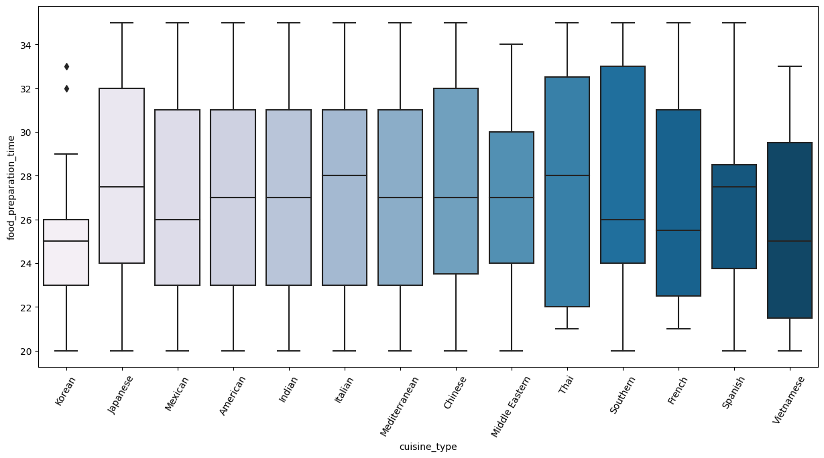
Multivariate Analysis (3/12): Cuisine Type vs Preparation Time²³
Thai dishes have the greatest variability in preparation time whereas the least variability is registered for Korean dishes
Italian and Thai dishes generally have the longest preparation time followed by Japanese and Spanish dishes whereas Korean and Vietnamese dishes are the most rapidly prepared dishes
Some Korean dishes took abnormally long to prepare

Slide 30
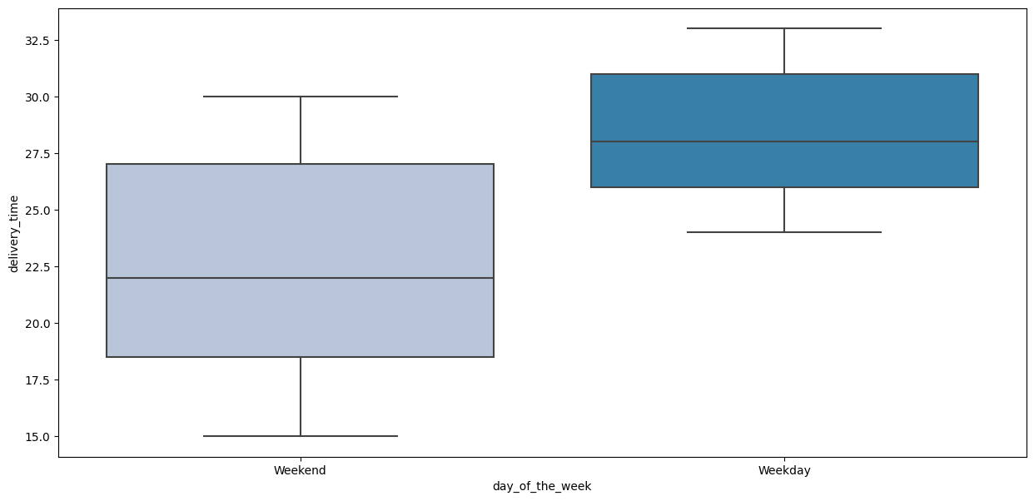
Multivariate Analysis (4/12): Day of the week vs Delivery Time
Delivery time during weekdays is significantly higher than during the weekend²⁴
Weekend delivery times tend to be more variable than weekday delivery times²⁴
On average, orders are delivered in 28 minutes on weekdays and 22 minutes on weekends²⁵

Slide 31
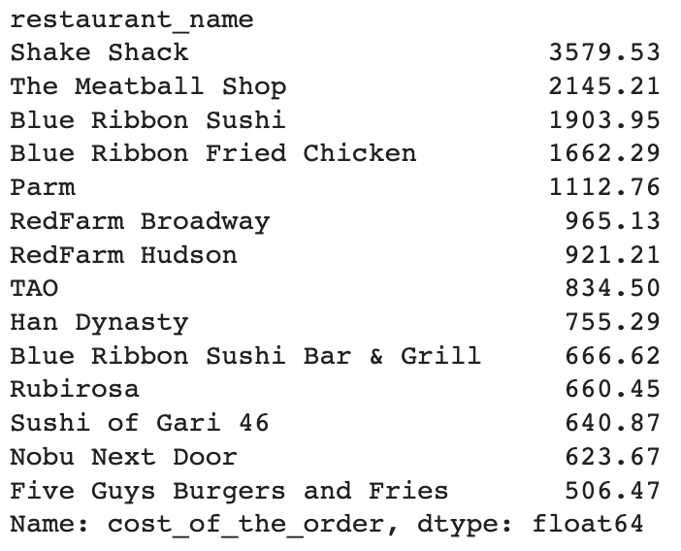
Multivariate Analysis (5/12): Restaurant Name vs Cost²⁶
The top 14 restaurants in terms of revenue raised between 506 and 3580 dollars each from the orders
'Shake Shack' generated the greatest amount of revenue from the orders (3580 dollars) followed by 'The Meatball Shop' (2145 dollars)
Among the top 14 restaurants, 'Five Guys Burgers and Fries' registered the least revenue (506 dollars) followed by 'Nobu Next Door' (623 dollars)

Slide 32
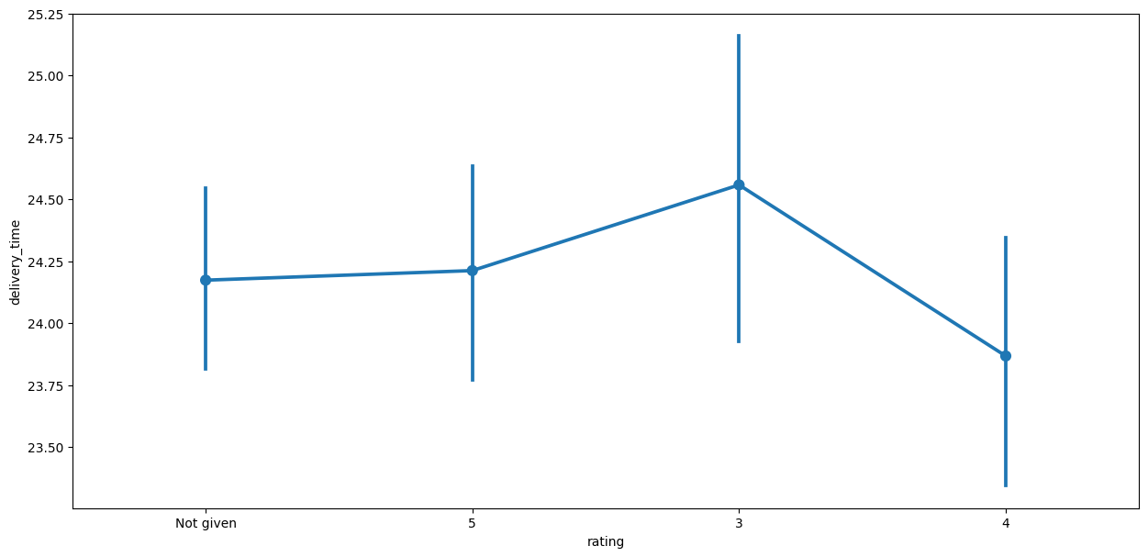
Multivariate Analysis (6/12): Rating vs Delivery Time²⁷
Orders with the longest delivery time were generally rated 3 whereas those with the least delivery time were rated 4 on average.

Slide 33
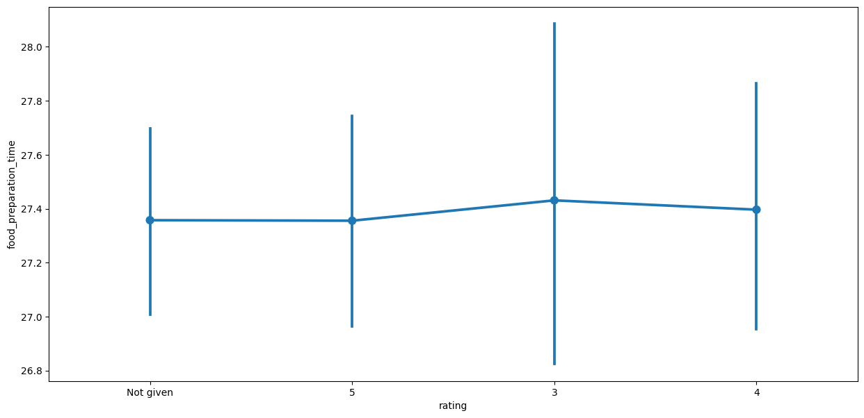
Multivariate Analysis (7/12): Rating vs Preparation Time²⁸
There is hardly any observable relationship between the food preparation time and the rating though orders with the longest preparation time and widest preparation time variability register a rating of 3 on average

Slide 34
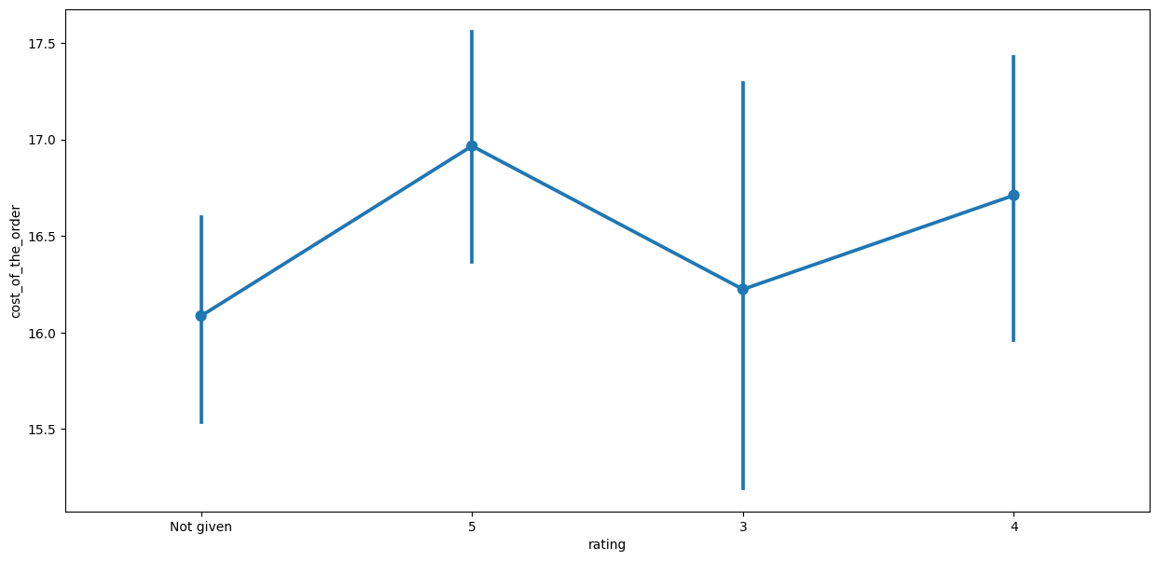
Multivariate Analysis (8/12): Rating vs Cost²⁹
The variability of cost is greatest for orders rated 3
Among the dishes rated, the most costly dishes are rated 5 whereas the least are rated 3
The cheapest dishes tend not to be rated

Slide 35
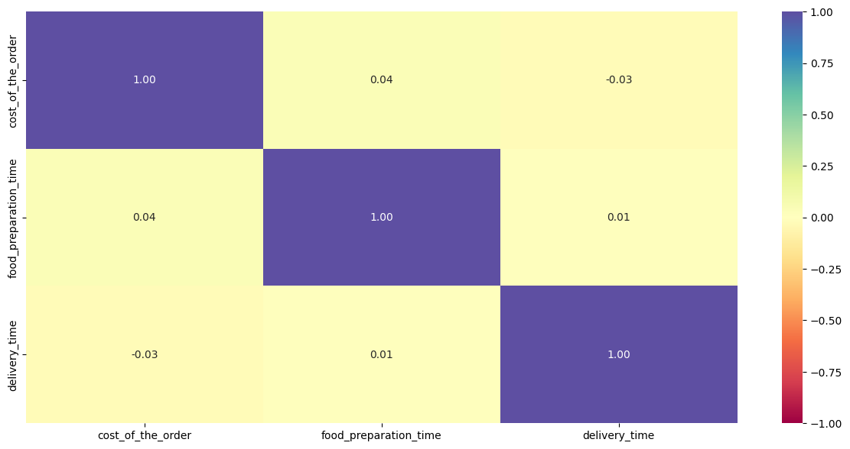
Multivariate Analysis (9/12): Cost vs Preparation Time vs Delivery Time³⁰
There is hardly any correlation among delivery time, food preparation time, and cost of the order
Correlation between preparation time and cost and between preparation time and delivery time is slightly positive
Delivery time and cost are slightly negatively correlated

Slide 36
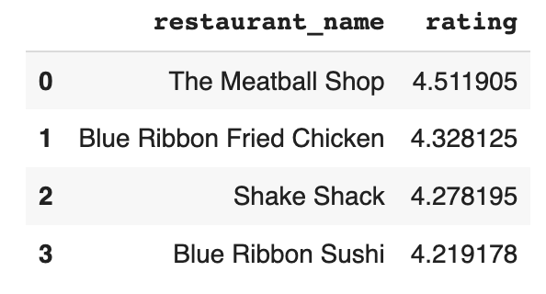
Multivariate Analysis (10/12): Rating vs Restaurant Name³¹
It turns out each restaurant having registered more than 50 ratings also has an average rating of over 4
Only 4 (2.25%) restaurants respect these criteria and are, thus, eligible for the promotional offer: 'The Meatball Shop', 'Blue Ribbon Fried Chicken', 'Shake Shack', and 'Blue Ribbon Sushi'

Slide 37
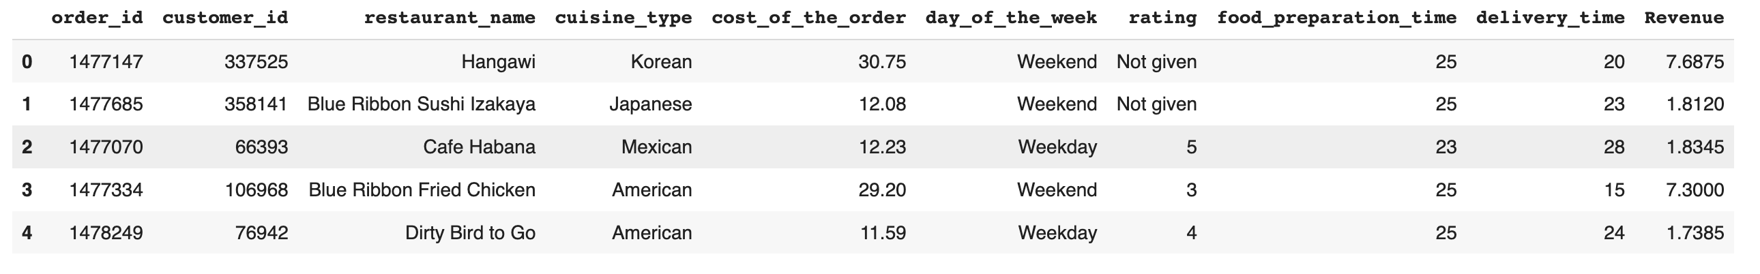
Multivariate Analysis (11/12): Cost of orders vs FoodHub’s Revenue³²
The revenue raised by FoodHub is around 6166.3 dollars

Slide 38
Multivariate Analysis (12/12): Total Delivery Time (Delivery Time + Preparation Time)³³
A total of 200 (10.54%) orders were delivered in more than 60 minutes from the time the order is placed

Slide 39
APPENDIX

Slide 40
Code Snippets (1/4)
df.shape
df.info()
df.isnull().sum()
df.describe(include='all')
df['rating'].value_counts()
df['order_id'].nunique()
df['customer_id'].nunique()
df['restaurant_name'].nunique()
df['customer_id'].value_counts().head(3)
df['cuisine_type'].nunique()
plt.figure(figsize = (15,5))
sns.countplot(data = df, x = 'cuisine_type')
df['restaurant_name'].value_counts()
sns.histplot(data=df,x='cost_of_the_order’)
plt.show()
sns.boxplot(data=df,x='cost_of_the_order’)
plt.show()
df_greater_than_20 = df[df['cost_of_the_order']>20]
print('The number of total orders that cost above 20 dollars is:', df_greater_than_20.shape[0])
percentage = (df_greater_than_20.shape[0] / df.shape[0]) * 100
print("Percentage of orders above 20 dollars:", round(percentage, 2), '%')
df['day_of_the_week'].unique(
sns.countplot(data = df, x = 'day_of_the_week')

Slide 41
Code Snippets (2/4)
df['rating'].unique()
sns.countplot(data = df, x = 'rating')
sns.histplot(data=df,x='food_preparation_time’)
plt.show()
sns.boxplot(data=df,x='food_preparation_time’)
plt.show()
sns.histplot(data=df,x='delivery_time’)
plt.show()
sns.boxplot(data=df,x='delivery_time’)
plt.show()
df_weekend = df[df['day_of_the_week'] == 'Weekend’]
df_weekend['cuisine_type'].unique()
plt.figure(figsize=(15,7))
sns.boxplot(x = "cuisine_type", y = "cost_of_the_order", data = df, palette = 'PuBu’)
plt.xticks(rotation = 60)
plt.show()
plt.figure(figsize=(15,7))
sns.boxplot(x = "cuisine_type", y = "food_preparation_time", data = df, palette = 'PuBu')
plt.xticks(rotation = 60)
plt.show()

Slide 42
Code Snippets (3/4)
plt.figure(figsize=(15,7))
sns.boxplot(x = "day_of_the_week", y = "delivery_time", data = df, palette = 'PuBu’)
plt.show()
print('The mean delivery time on weekdays is around’, round(df[df['day_of_the_week'] == 'Weekday']['delivery_time'].mean()), 'minutes’)
print('The mean delivery time on weekends is around’, round(df[df['day_of_the_week'] == 'Weekend']['delivery_time'].mean()), 'minutes’
df.groupby(['restaurant_name'])['cost_of_the_order'].sum().sort_values(ascending = False).head(14)
plt.figure(figsize=(15, 7))
sns.pointplot(x = 'rating', y = 'delivery_time', data = df)
plt.show()
plt.figure(figsize=(15, 7))
sns.pointplot(x = 'rating', y = 'food_preparation_time', data = df)
plt.show()
plt.figure(figsize=(15, 7))
sns.pointplot(x = 'rating', y = 'cost_of_the_order', data = df)
plt.show()
col_list = ['cost_of_the_order', 'food_preparation_time', 'delivery_time’]
plt.figure(figsize=(15, 7))
sns.heatmap(df[col_list].corr(), annot=True, vmin=-1, vmax=1, fmt=".2f", cmap="Spectral")
plt.show()

Slide 43
Code Snippets (4/4)
df_rated = df[df['rating'] != 'Not given'].copy()
df_rated['rating'] = df_rated['rating'].astype('int’)
df_rating_count = df_rated.groupby(['restaurant_name'])['rating'].count().sort_values(ascending = False).reset_index()
df_rating_count.head()
rest_names = df_rating_count[df_rating_count['rating'] > 50]['restaurant_name’]
df_mean_4 = df_rated[df_rated['restaurant_name'].isin(rest_names)].copy()
df_mean_4.groupby(['restaurant_name'])['rating'].mean().sort_values(ascending = False).reset_index().dropna()
def compute_rev(x):
if x > 20:
return x*0.25
elif x > 5:
return x*0.15
else:
return x*0
df['Revenue'] = df['cost_of_the_order'].apply(compute_rev)
df.head()
total_rev = df['Revenue'].sum()
print('The net revenue is around', round(total_rev, 2), 'dollars')
df['total_time'] = df['food_preparation_time'] + df['delivery_time’]
df_delivery_greater_than_60 = df[df['total_time']>60]
print('The number of total orders whose delivery time is more than 60 minutes is:', df_delivery_greater_than_60.shape[0])
percentage = (df_delivery_greater_than_60.shape[0] / df.shape[0]) * 100
print("Percentage of orders delivered in more than 60 minutes:", round(percentage, 2), '%')

